Slide 1
Lecture 7
Quality of solution
Depth First Iterative Deepening (DFID) Search
Bidirectional search

Slide 2
Quality of solution
Formulation of problem solving does not include any explicit cost for the moves or choices made.
Consequently, the only quality measure we can talk of is the length of the solution.
That is, we consider solutions with smaller number of moves as better.
Where BFS loses out on space complexity, it makes up on the quality of the solution.
Since it pushes into the search space level by level, the Breadth First Search inspects candidate solutions in increasing order of solution length.
Consequently, it will always find the shortest solution.

Slide 3
This is a major advantage in many domains.
Depth First Search on the other hand, dives down into the search tree.
It backtracks if it reaches a dead end, and tries other parts of the search space.
It returns the first solution found, which holds no guarantee that it will be the shortest one.
Given a search tree with two goal nodes as shown in Figure in next slide, DFS will find the longer solution deeper in the search tree.
Thus, it can find a non-optimal solution.
On the other hand, since BFS pushes into the search tree, it will always find the shortest solution.
So, this is one feature where BFS is better than DFS.

Slide 4
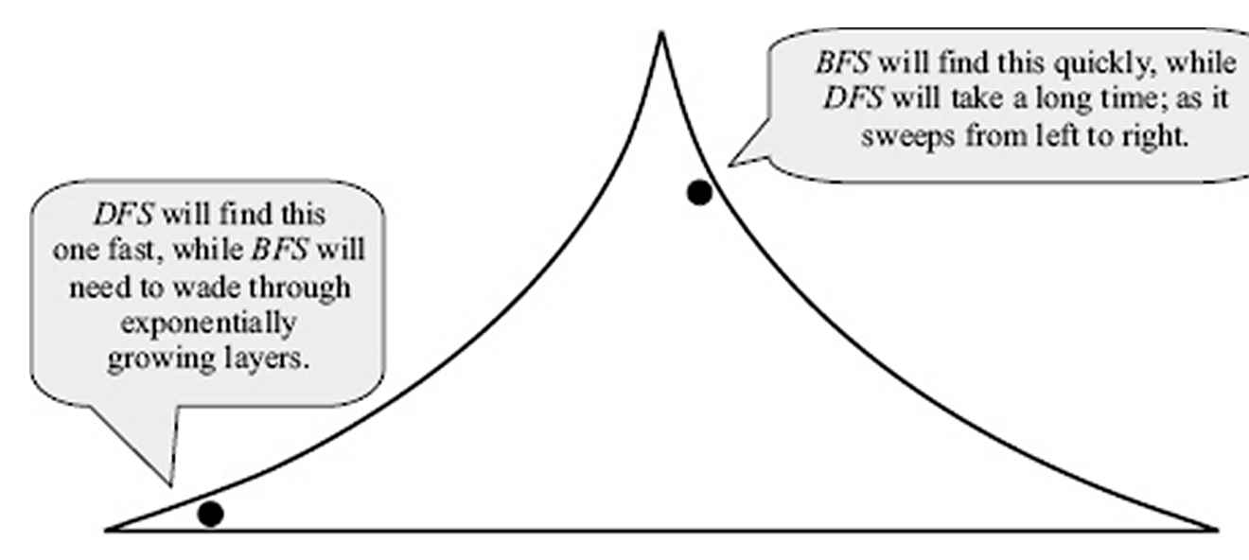
In fact, if the search space is infinite, there is a danger that DFS will go into a never-ending path and never return a solution!

Slide 5
Depth First Iterative Deepening (DFID) search
The hard part about depth-limited search is picking a good limit. We picked 19 as an "obvious” depth limit for the Romania problem, but in fact if we studied the map carefully, we would discover that any city can be reached from any other city in at most 9 steps.
This number, known as the diameter of the state space, gives us a better depth limit, which leads to a more efficient depth-limited search.
However, for most problems, we will not know a good depth limit until we have solved the problem.
Iterative deepening search is a strategy that sidesteps the issue of choosing the best depth limit by trying all possible depth limits: first depth 0, then depth 1, then depth 2, and so on.

Slide 6
In effect, iterative deepening combines the benefits of depth-first and breadth-first search.
It is optimal and complete, like breadth-first search, but has only the modest memory requirements of depth-first search.
The order of expansion of states is similar to breadth-first, except that some states are expanded multiple times.
Figure next slide shows the first four iterations of ITERATIVE-DEEPENING-SEARCH on a binary search tree.

Slide 7
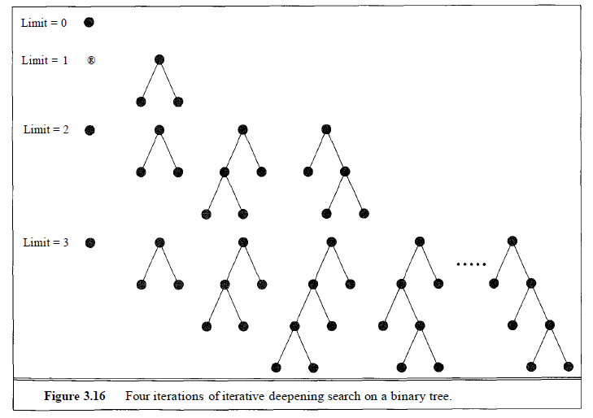

Slide 8

Iterative deepening search may seem wasteful, because so many states are expanded multiple times.
For most problems, however, the overhead of this multiple expansion is actually rather small.
Intuitively, the reason is that in an exponential search tree, almost all of the nodes are in the bottom level, so it does not matter much that the upper levels are expanded multiple times.
Recall that the number of expansions in a depth-limited search to depth d with branching factor b is

Slide 9
To make this concrete, for b = 10 and d = 5. the number is
1 + 10+100+1,000+10,000+ 100,000= 111,111
In an iterative deepening search, the nodes on the bottom level are expanded once, those on the next to bottom level are expanded twice, and so on, up to the root of the search tree, which is expanded d + 1 times.
So the total number of expansions in an iterative deepening search is
(d + 1)1 + (d)b + (d- 1)b² + ••• + 3b^{d-2} + 2b^{d-1}+ b^{d}
Again, for b = 10 and d = 5 the number is
6 + 50 + 400 + 3,000 + 20,000+100,000= 123,456

Slide 10
All together, an iterative deepening search from depth 1 all the way down to depth d expands only about 11 % more nodes than a single breadth-first or depth-limited search to depth d, when b = 10.
The higher the branching factor, the lower the overhead of repeatedly expanded states, but even when the branching factor is 2, iterative deepening search only takes about twice as long as a complete breadth-first search.
This means that the time complexity of iterative deepening is still O(b^{d}), and the space complexity is O(bd).
In general, iterative deepening is the preferred search method when there is a large search space and the depth of the solution is not known.

Slide 11
Bidirectional search
The idea behind bidirectional search is to start from both the end : from start state in forward direction and from goal state in backward direction.
For the problems where branching factor is b in both the directions, this search mechanism will make difference.
By assuming depth d and branching factor b, the solution can be found with o(b^{d/2})
Consider the example where b=10 and d=6.
Here with bidirectional search, instead of 11,11,111 nodes, you require 2,222 node to be explored from each side with depth of 3.
This looks great, but bidirectional search has many problems.

Slide 12
The major problem is, what does it mean to start from goal state? Searching backwards means generating predecessors successively starting from the goal state.
Calculating predecessors is more difficult.
What is to be done if there are multiple solutions?
There must be an efficient way to check each new node to see if it already appears in the search tree of the other half of the search.

Slide 13
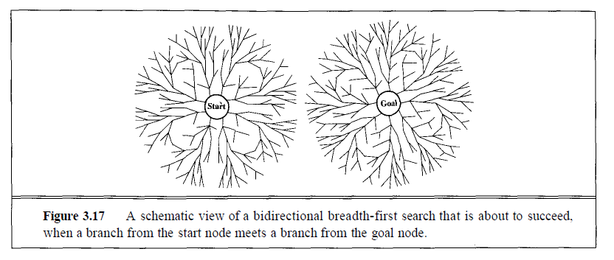

Slide 14
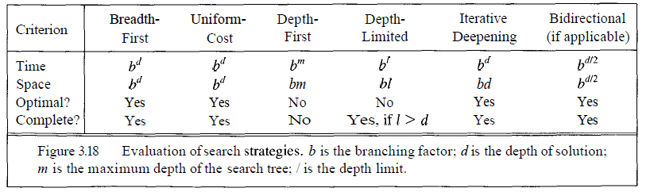
Comparison

